Slide 1
‘Being loved into life’
St Peter’s Ruddington
Lent Course 2025

Slide 2
Session 2: The Holy Spirit in Prayer

Slide 3
Initial discussion
How has your perception of prayer changed as a result of Andrew’s talk and your homework reflection?
What changes, if any, have you made in your prayer life in the light of these changed perceptions?

Slide 5
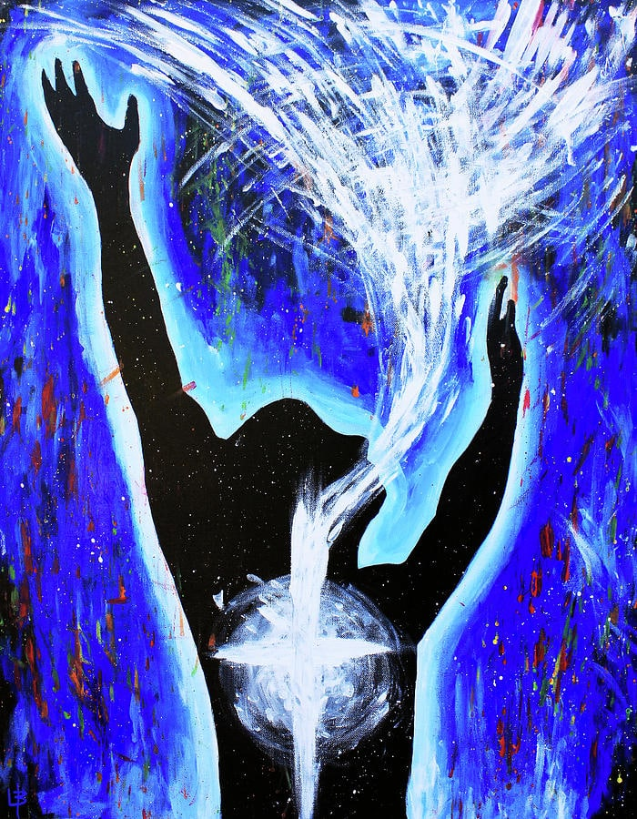

Slide 6
Prayer: Our lived relationship with God, accomplished under the influence of the Holy Spirit.

Slide 7
Two models of Spirituality
Western model: ‘Self outside God’
Father Son
Holy Spirit
Human Spirit
Grace
Self initiates: God rewards
Body Mind

Slide 8
Two models of Spirituality:
Scriptural Model: Self-in-God
Father Son
Human Spirit
Grace
Holy Spirit
Body Mind
God initiates: Self responds

Slide 9
At that time Jesus, full of joy through the Holy Spirit, said, ‘I praise you, Father, Lord of heaven and earth, because you have hidden these things from the wise and learned, and revealed them to little children. Yes, Father, for this is what you were pleased to do.
Luke 10:21

Slide 10
²⁶ In the same way, the Spirit helps us in our weakness. We do not know what we ought to pray for, but the Spirit himself intercedes for us through wordless groans. ²⁷ And he who searches our hearts knows the mind of the Spirit, because the Spirit intercedes for God’s people in accordance with the will of God.
Romans 8:26-27

Slide 11
How does the Holy Spirit enable us to ‘live out’ our relationship with God?
The Holy Spirit empowers us to love.

Slide 12
⁷ My dear people, let us love one another, since love comes from God and everyone who loves is begotten by God and knows God. Anyone who fails to love can never have known God, because God is love…No one has ever seen God; but as long as we love one another God will live in us and his love will be complete in us because he lets us share his Spirit.
1 John 4:7-8, 12-13 New Jerusalem Version.

Slide 13
“…the love God has poured into our hearts by the Holy Spirit which has been given us.”
Romans 5:5

Slide 14
For those who are led by the Spirit of God are the children of God. The Spirit you received does not make you slaves, so that you live in fear again; rather, the Spirit you received brought about your adoption to sonship. And by him we cry, ‘Abba, Father.’ The Spirit himself testifies with our spirit that we are God’s children.
Romans 8:14-16

Slide 15
Be completely humble and gentle; be patient, bearing with one another in love. Make every effort to keep the unity of the Spirit through the bond of peace. There is one body and one Spirit, just as you were called to one hope when you were called; one Lord, one faith, one baptism;
Ephesians 4:2-5

Slide 16
How does the Holy Spirit enable us to ‘live out’ our relationship with God?
The Holy Spirit empowers us to love.
The Holy Spirit guides us in the best ways to express this love.

Slide 17
‘All this I have spoken while still with you. But the Advocate, the Holy Spirit, whom the Father will send in my name, will teach you all things and will remind you of everything I have said to you.
John 14:25-26

Slide 18
“Let me put it like this: if you are guided by the Spirit you will be in no danger of yielding to self-indulgence, since self-indulgence is the opposite of the Spirit, the Spirit is totally against such a thing, and precisely because the two are so opposed that you do not carry out your good intentions.
Galatians 5:16-17

Slide 19
“Since the Spirit is our life, let us be directed by the Spirit.”
Galatians 5:25

Slide 20
“It seemed good to the Holy Spirit, and to us, not to burden you with anything beyond the following requirements: You are to abstain from food sacrificed to idols, from blood, from the meat of strangled animals and from sexual immorality. You will do well to avoid these things.”
Acts 15:28-29

Slide 21
How does the Holy Spirit enable us to ‘live out’ our relationship with God?
The Holy Spirit empowers us to love.
The Holy Spirit guides us in the best ways to express this love.
The Holy Spirit is our source of strength to actually love and serve both God and others.

Slide 22
“There is a variety of gifts but always the same Spirit; there are sorts of service to be done, but always the same Lord; working in all sots of different ways in different people, it is the same God who is working in all of them. He particular way in which the Spirit is given to each person is for a good purpose. One may have the gift of preaching with wisdom given him by the Spirit;

Slide 23
another may have the gift of instruction given him by the same Spirit; and another the gift of faith given by the same Spirit; another the gift of healing, through this one Spirit; one, power of miracles; another, prophecy; another the gift of recognising spirits; another the gift of tongues and another the ability to interpret them. All these are the work of the one and the same Spirit, who distributes gifts to different people just as he chooses.
1 Corinthians 12:4-11

Slide 24
But you will receive power when the Holy Spirit comes on you; and you will be my witnesses in Jerusalem, and in all Judea and Samaria, and to the ends of the earth.’
Acts 1:8

Slide 25
Small group discussion questions:
Did anything Andrew say about the Holy Spirit resonate with your experience?
Did anything Andrew say sound new to your own experience of prayer?
Discuss any experience you have had of the Spirit as:
  Unifier
  Enlightener
  Enabler

